Slide 1
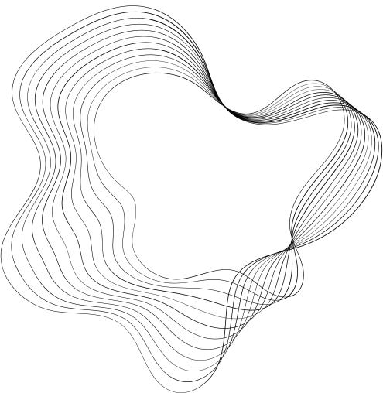

LEVERAGING SPARK NLP AND MLLIB FOR BIG DATA TEXT ANALYSIS

Slide 2

GROUP MEMBERS
Bharath L (22bds013)
Dhrithi K (22bds018)
Gnanesh A R (22bds023)
Gopal (22bds025)
Madhan S (22bds036)

Slide 3


UNDER THE GUIDANCE OF
Dr.Animesh Chaturvedi,
Associate Professor Dept. of DSAI , IIIT Dharwad.

Slide 4
CONTENT
01
HADOOP
02
SPARK
03
ML ALGORITHM
04
CODE RUN
05
ANALYSIS

Slide 5
HADOOP
What is Hadoop?
Hadoop is an open-source framework used for storing and processing large volumes of data in a distributed computing environment. It's designed to handle massive datasets across clusters of commodity hardware.
Key Components:
1. Hadoop Distributed File System (HDFS): A distributed file system that stores data across multiple machines.
2. MapReduce: A programming model for processing and generating large datasets in parallel.
3. YARN (Yet Another Resource Negotiator): Resource management layer responsible for managing computing resources in the Hadoop ecosystem.
4. Hadoop Common: Contains libraries and utilities needed by other Hadoop modules.
Source : https://hadoop.apache.org/docs/stable/hadoop-project-dist/hadoop-common/SingleCluster.html

Slide 6

SPARK
Open-source, in-memory application framework.
Provides parallel & distributed processing, scalability & fault tolerance.
Keeps as much of the data required in-memory & avoids disk I/O.
Follows a master/slave architecture with two main daemons and a cluster manager (Master Daemon & Worker Daemon)
It can be used with various data sources such as HDFS, HBase, Cassandra, and Amazon S3 and supports multiple programming languages including Java, Scala, and Python.
Source : https://spark.apache.org/docs/latest/quick-start.html

Slide 7
SPARK NLP
Why Spark NLP?
Specializes in NLP tasks with deep learning and scalability.
Ideal for production-level text processing in big data applications.
Key Components of Spark NLP
DocumentAssembler: Converts raw text into a Spark DataFrame for processing.
Tokenizer: Splits text into individual words or tokens.
Stemmer/Lemmatizer: Reduces words to their root or base forms.
Word Embeddings: Converts text into numerical vectors using models like BERT, Word2Vec, etc.
Pipeline: Chains multiple NLP components into a reusable workflow.
Source : https://sparknlp.org/

Slide 8
SPARK MLLIB
Scalable: Processes large datasets across distributed clusters.
Integrated: Works seamlessly with Spark DataFrames.
Versatile: Offers diverse ML algorithms and workflows.
Efficient: Optimized for big data applications.
User-Friendly: High-level Pipelines simplify ML processes.
Source : https://spark.apache.org/mllib/

Slide 9

Logistic Regression(LR)
Logistic Regression is a supervised learning algorithm used
primarily for classification tasks. It models the probability
that an input belongs to a particular class by applying a
logistic (sigmoid) function to a linear combination of the input
features
Source : https://spark.apache.org/docs/latest/ml-classification-regression.html#logistic-regression

Slide 10
LR pseudo code
Algorithm 1 Logistic Regression Training Algorithm
Input: Training data with features and labels
Output: Trained model parameters
Initialization:
1: Initialize model weights and bias
Training Process:
2: for each training sample do
3: Compute the weighted sum z of inputs
4: Apply the sigmoid function to z to get a probability p
5: Compute the error by comparing p with the actual label
6: Update weights and bias based on the error using
gradient descent
7: end for
8: return Trained model parameters

Slide 11

Decision Tree (DT)
Decision Tree is a non-parametric supervised learning algorithm used for both classification and regression tasks.
It recursively splits the data based on feature values, creatingbranches that lead to decision outcomes.
Source : https://spark.apache.org/docs/latest/mllib-decision-tree.html

Slide 12
DT pseudo code
Algorithm 2 Decision Tree Trainig Algorithm
Input: Training data with features and labels
Output: Trained decision tree
Initialization:
1: Start with the entire dataset as the root
Training Process:
2: while stopping criteria not met do
3: For each node, evaluate possible splits on all features
4: Choose the split that maximizes a purity metric (e.g.,
Gini impurity, entropy)
5: Split the data based on the chosen feature and value,
creating child nodes
6: Recursively repeat the process for each child node
7: end while
8: return Constructed decision tree

Slide 13
RANDOM FOREST (RF)
Random Forest is an ensemble learning method that com-
bines multiple decision trees to improve classification regression performance.
Each tree is trained on a random
subset of data and features, which reduces overfitting and
increases generalization
Source:https://spark.apache.org/docs/latest/ml-classification-regression.html#random-forest-classifier

Slide 14
RF PSEUDO CODE
Algorithm 3 Random Forest Training Algorithm
Input: Training data with features and labels, number of trees
Output: Trained forest of decision trees
Initialization:
1: Initialize an empty forest
Training Process:
2: for each tree in the forest do
3: Draw a random sample of the data (with replacement)
4: Select a random subset of features for splitting at each
node
5: Train a decision tree on the sampled data and selected
features
6: Add the trained tree to the forest
7. end for
Prediction Process (for new data):
8: Obtain predictions from each tree in the forest
9: Aggregate predictions (e.g., majority vote for classifica-
tion)
10: return Final aggregated prediction or trained forest model

Slide 15
Neural Network (NN)
Neural Networks are a set of algorithms modeled after the
human brain, designed to recognize patterns in data.
They consist of multiple layers of interconnected nodes (neurons)
that process and learn from input data through a series of
transformations.
source:https://spark.apache.org/docs/latest/ml-classification-regression.html#multilayer-perceptron-classifier

Slide 16
NN pseudo code
Algorithm 4 Neural Network Training Algorithm
Input: Training data with features and labels, network architecture (layers, neurons, activation functions), learning
rate, number of epochs
Output: Trained neural network model
Initialization:
1: Initialize weights and biases for all layers
Training Process:
2: for each epoch do
3: for each training sample do
4: Forward pass: Compute activations for each layer
5: Compute the output and loss using the target label
6: Backward pass: Compute gradients of the loss with
respect to weights and biases
7: Update weights and biases using gradient descent or
another optimization algorithm
8: end for
9: end for
10: return Trained neural network model

Slide 17
DATASET DESCRIPTION
The dataset consists of 3700 texts (length in words: min=16, avg=280, max=566).
It includes manually labeled English food recall titles from official food agency websites (e.g., FDA).
Each text is labeled by two food science or food technology experts.
Features: text , hazard-category
Source: https://zenodo.org/doi/10.5281/zenodo.10820657

Slide 18
CODE EXECUTION

Slide 19
RESULTS

Slide 20
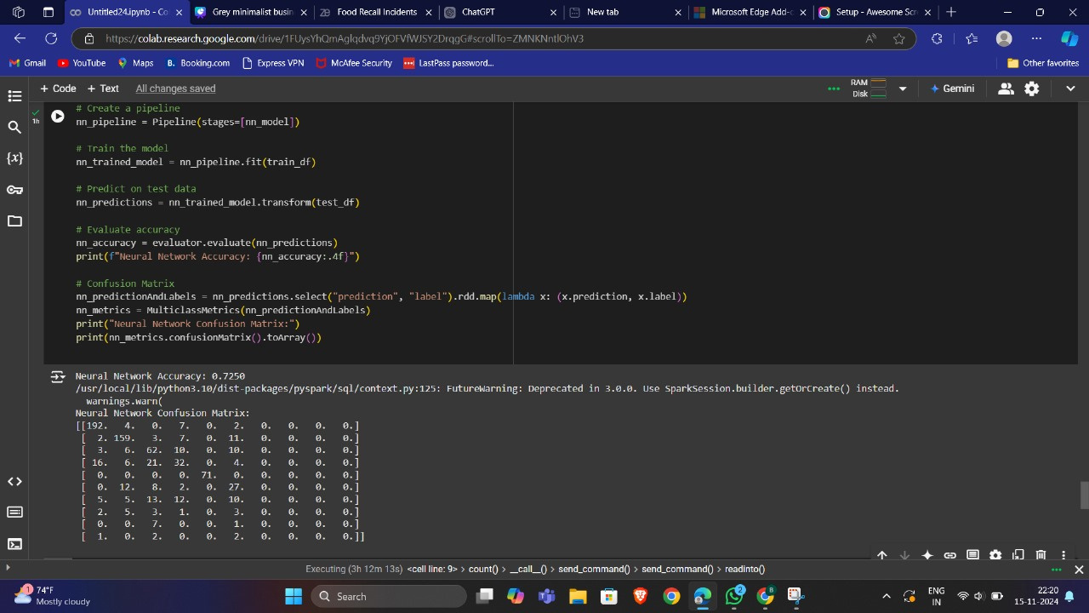
NEURAL NETWORK

Slide 21
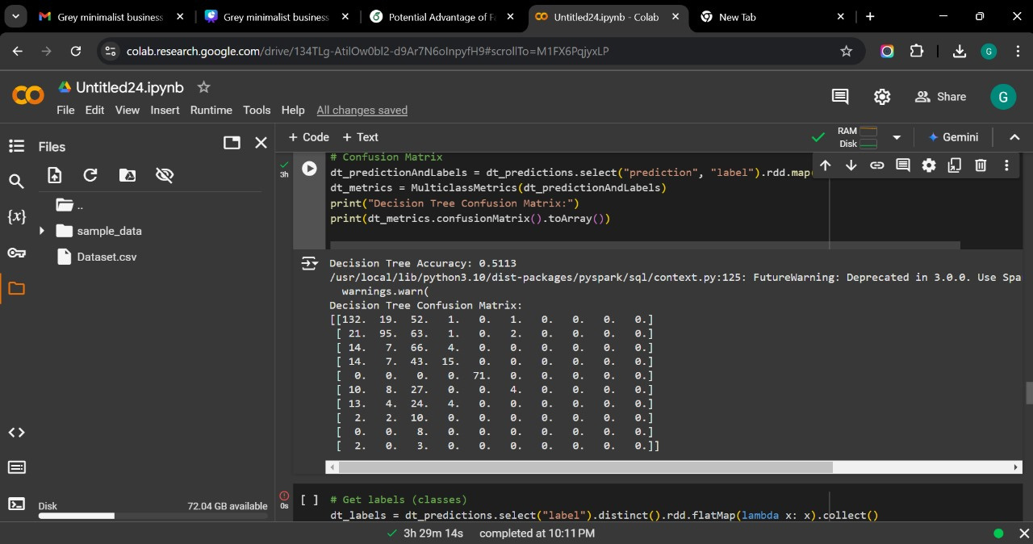
DECISION TREE

Slide 22
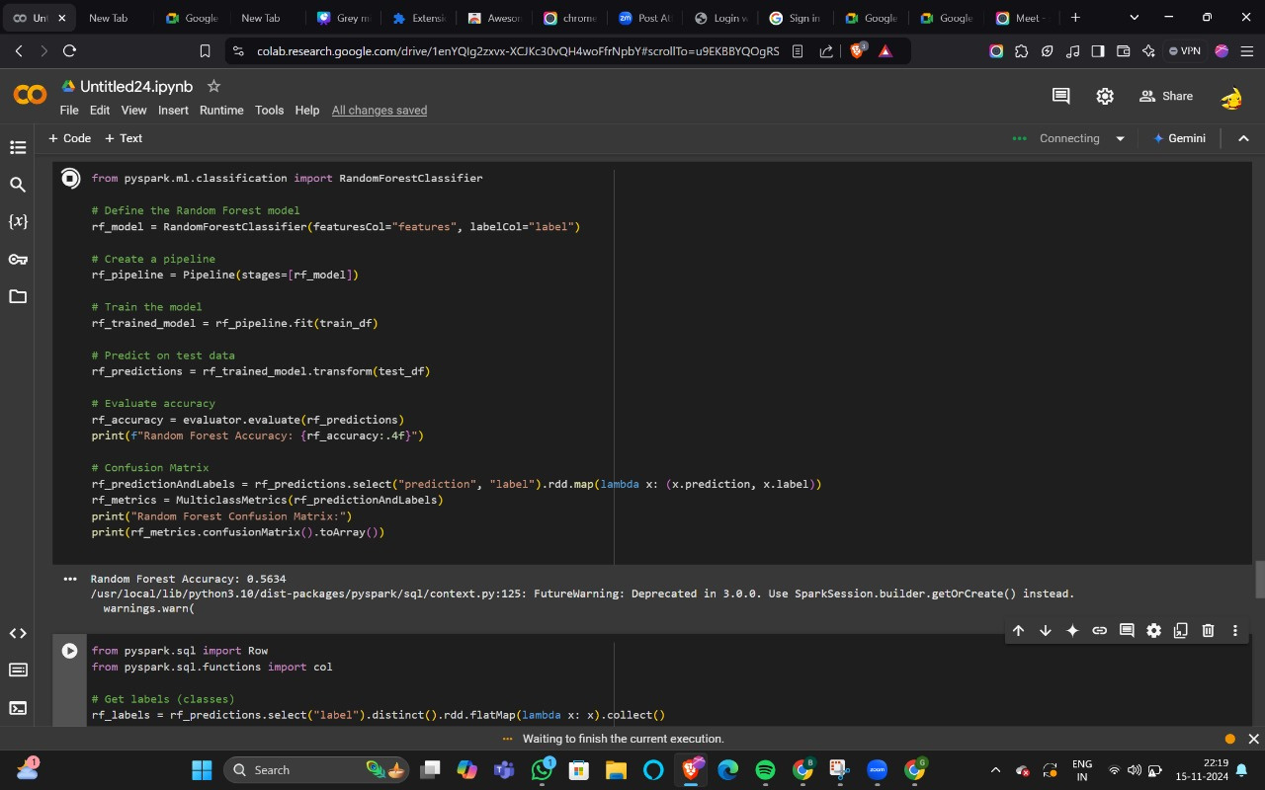
RANDOM FOREST

Slide 23
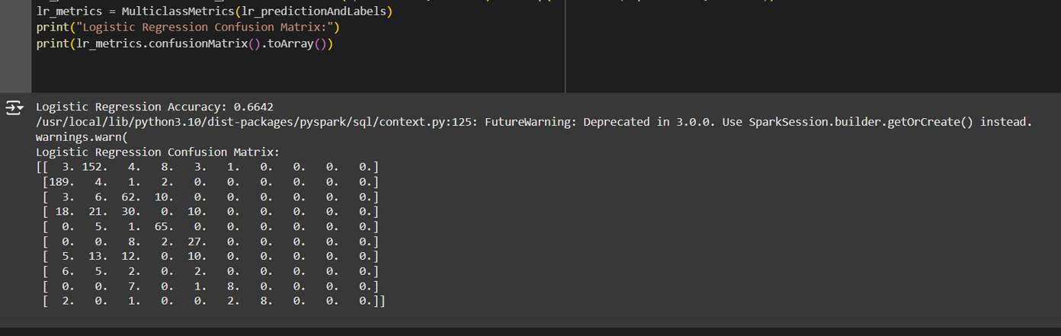
LOGISTIC REGRESSION

Slide 24
FINAL INFERENCE
Based on the performance of the four algorithms—Neural Network (72.50%), Logistic Regression (66.42%), Random Forest (56.34%), and Decision Tree (51.13%)
Takeaway is that the Neural Network model is the most effective for predicting food hazards in your dataset. With an accuracy of 72.50%, it significantly outperforms the other models, suggesting that it is able to better capture the complex, non-linear relationships in the data, which is common in real-world datasets with multiple interacting factors.

Slide 25


